Slide 1
Web development UI

Slide 2
HTML Contents.
In this module following topics will be discussed.
  Elements.
  Attributes.
  Headings.
  Paragraphs.
  Formatting.
  Links.
  CSS
  Images
  Tables

Slide 3
HTML Contents.
  Lists
  Blocks
  Layout.
  Forms.
  Iframes.

Slide 4
HTML- Introduction
HTML Stands for Hyper Text Markup Language.
It will use set of built in tags.
HTML code will have the file extension as .html.
HTML is used to write User Interface for Web Development programs.

Slide 5
Writing HTML code.
Any text editor can be used to write HTML code.
It should have the extension of .HTML.
Notepad, NotePad++, Visual Studio, Eclipse can also be used to develop HTML code.
WebStorm from JetBrains also can be used for developing HTML, CSS, Java Script, Jquery code easily.

Slide 6
Best free editor.
Notepad++ is a free editor and it is very good for HTML development.
You can download Notepad++ from the following web site.
  http://notepad-plus-plus.org/download/v6.6.9.html
Install Notepad++.
Type the following code:
<html>
<body>
<h1> Hello and welcome to HTML </h1>
</body>
</html>

Slide 7
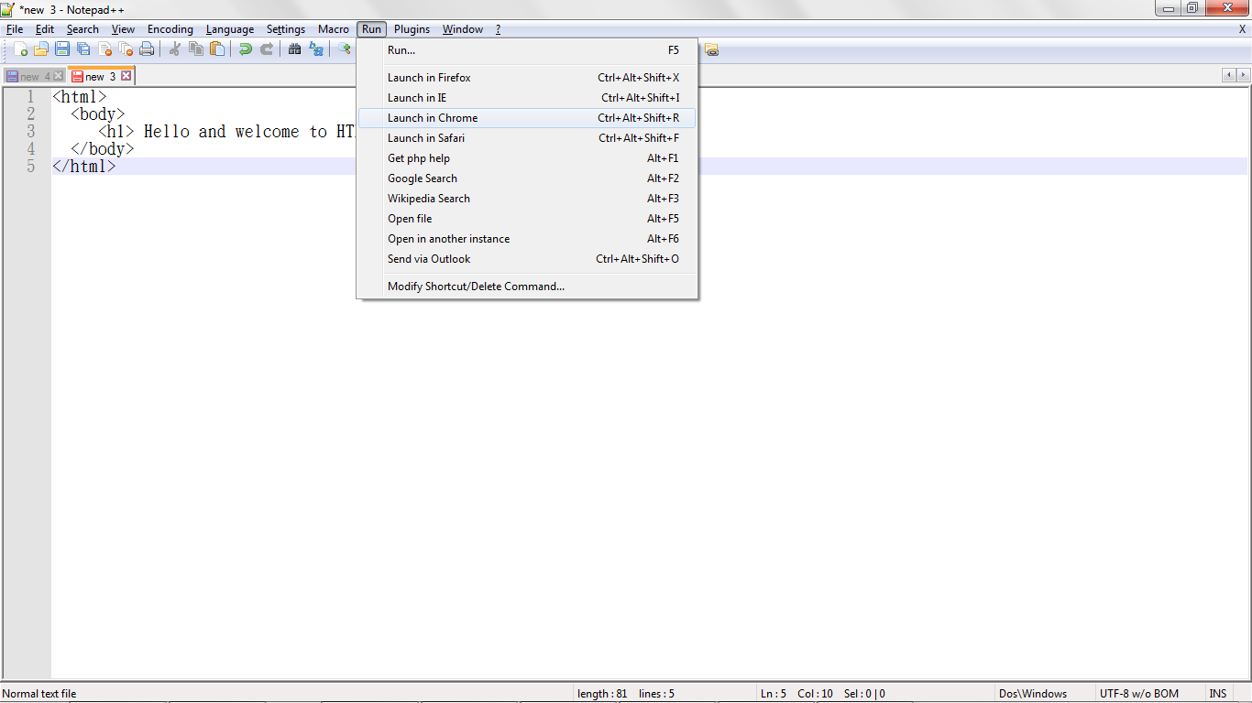
Run the programs in Notepad++
Run the HTML code in the following manner.
  Click on Run menu and click on Launch IE/Chrome/Safari etc., based on the browser installed on your system.
  Save the file with .html as the extension.

Slide 8
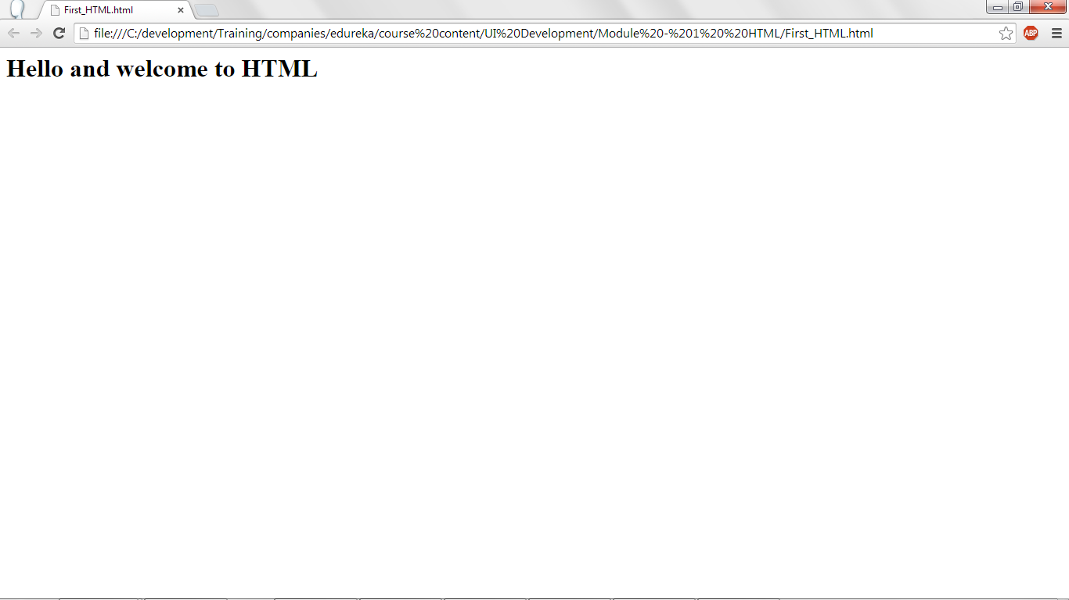
Output of this program.

Slide 9
HTML Elements.
HTML documents are developed using HTML Elements.
HTML Elements have the start tag and end tag and the content in between.
The format is:
    <tag> Data </tag>
Here the tag is HTML tag and the data has to be in-between the tag. For example:
    <h1> Welcome to HTML! </h1>
Here h1 is a header tag. <h1> is start of the header tag and </h1> is the end of the header tag. Welcome to HTML is the data and it will be displayed on the screen.
HTML Elements are not case sensitive.

Slide 10
Nesting of elements.
An element can be inside another element which is called as Nesting of Elements.
P is the tag for displaying paragraphs in HTML.
H1 tag and P tag can be used inside a body tag in HTML. Body tag defines the body of the HTML document.

Slide 11
HTML code for nesting elements.
<html>
<body>
<h1> Hello and welcome to HTML </h1>
<p> This is a paragraph. I am using P tag for this </p>
</body>
</html>

Slide 12
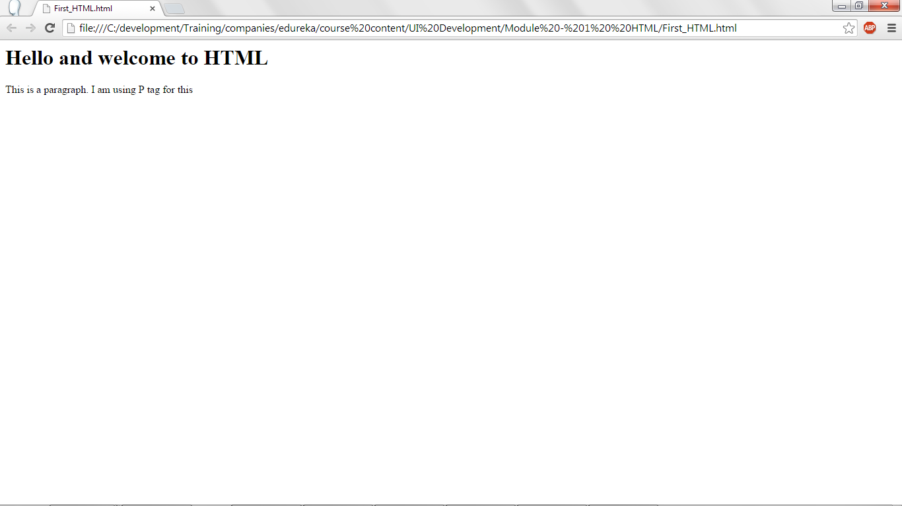
Output of the code.

Slide 13
HTML Attributes.
HTML Elements can have attributes.
Attributes specify additional information about the HTML Elements.
Attributes are specified in the start tag of the HTML element.
Attributes are always specified in key value pair. For example : Width=200. Here Width is the key and 200 is the value.

Slide 14
HTML Attributes.
<!DOCTYPE html>
<html>
<body>
<h2 title="This is Example of attribute on h2 tag.">Put the mouse over any text and get the tooltip</h2>
<p title="This is Example of attribute on p tag">Put the mouse over any text and get the tooltip.</p>
</body>
</html>

Slide 15
HTML Attributes.
<!DOCTYPE html> defines that the HTML code is using the standard way of web site development. If this tag is not mentioned then browser works on quirks mode, which is a non-standard way of Web site layout managment. HTML and CSS were not rendered properly in quircks mode, hence standard mode is opted by specifying !DOCTYPE tag.

Slide 16
HTML Attributes.
Title attibute is used for both H1 tag and P tag.
Title attribute will display the given title when the user moves the cursor on the element.
  Note : Moving the cursor on the element is called as Hovering.
When the mouse cursor is moved on H1 tag then Example of H1 tag is displayed as the tootip.
When hovered on P1 tag then example of p1 title is displayed as the tooltip.

Slide 17
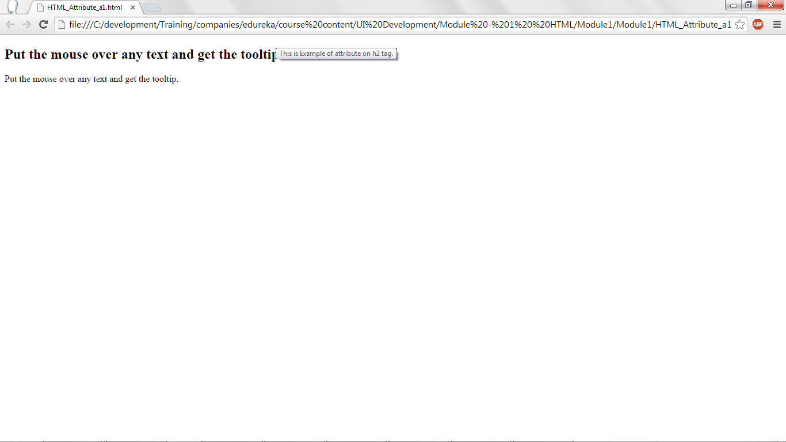
HTML title attribute – output.

Slide 18
HTML src attribute.
<!DOCTYPE html>
<html>
<body>
<img src="HTML_attribute_1.jpg"/>
<p>example of src attribute</p>
</body>
</html>

Slide 19
HTML src attribute.
In the img is an element and src is the attribute.
Src specifies the location and the file name of the image.
Here end tag </img> is not used. If there is no data in between the start tag and end tag then the start tag can be closed using /> symbol. As in.
  <img src=”image.jpg”/>

Slide 20
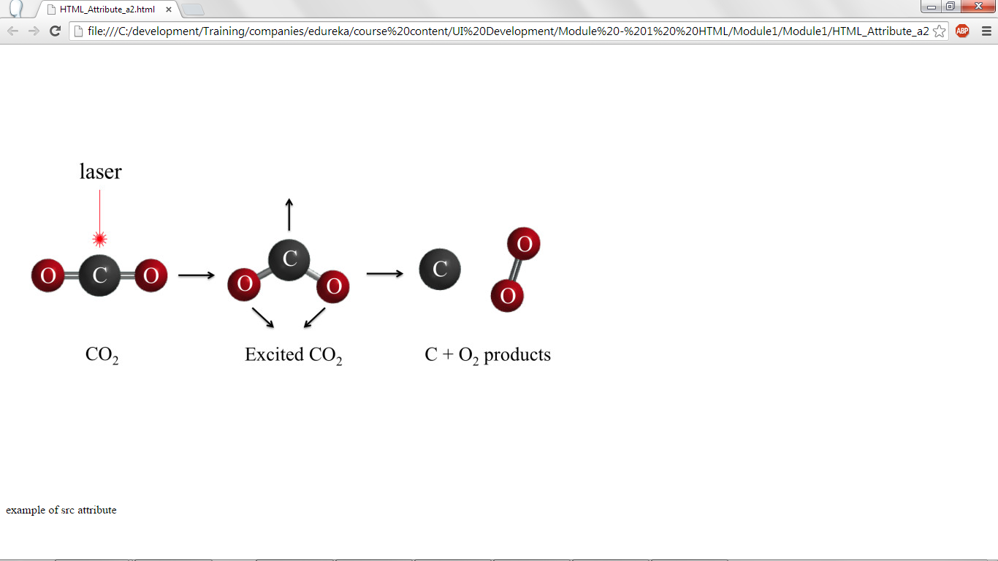
HTML src attribute – output.

Slide 21
HTML Attributes – height and width.
<!DOCTYPE html>
<html>
<body>
<img src="HTML_attribute_1.jpg" height="300" width="300"/>
<p>example of height,width attribute</p>
</body>
</html>

Slide 22
HTML Attributes – height and width.
Along with src attribute, height and width attribute is also specified.
Height and width are specified in pixels.
In the code height is specified as 300 pixes and width is specified as 300 pixes. Hence, the image fits in 300 x 300 pixes.
P tag is used to write paragraph.

Slide 23
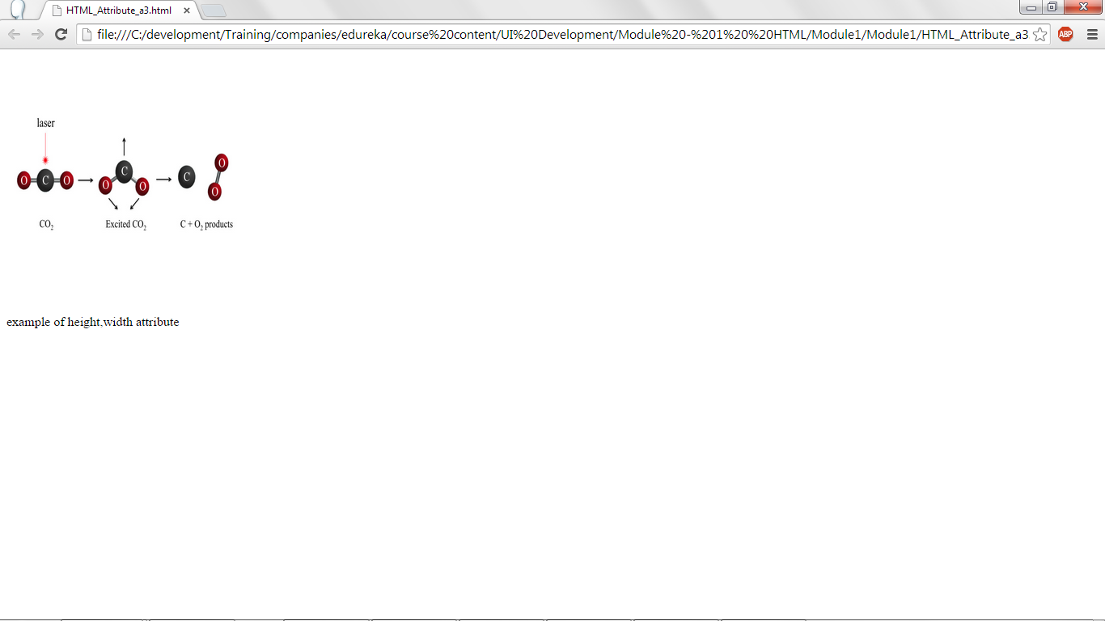
HTML Attributes – height and width – output.

Slide 24
HTML alt attribute.
<!DOCTYPE html>
<html>
<body>
<img src="a.jpg" height="300" width="300" alt="Sorry!The image is not available"/>
<p>example of alt attribute</p>
</body>
</html>
Alt message will be displayed when the image is not able to display. It could be due to image is not found or very slow net connection etc.,
If a.jpg is not available for the HTML code, Sorry! The image is not available message is displayed to the user.

Slide 25
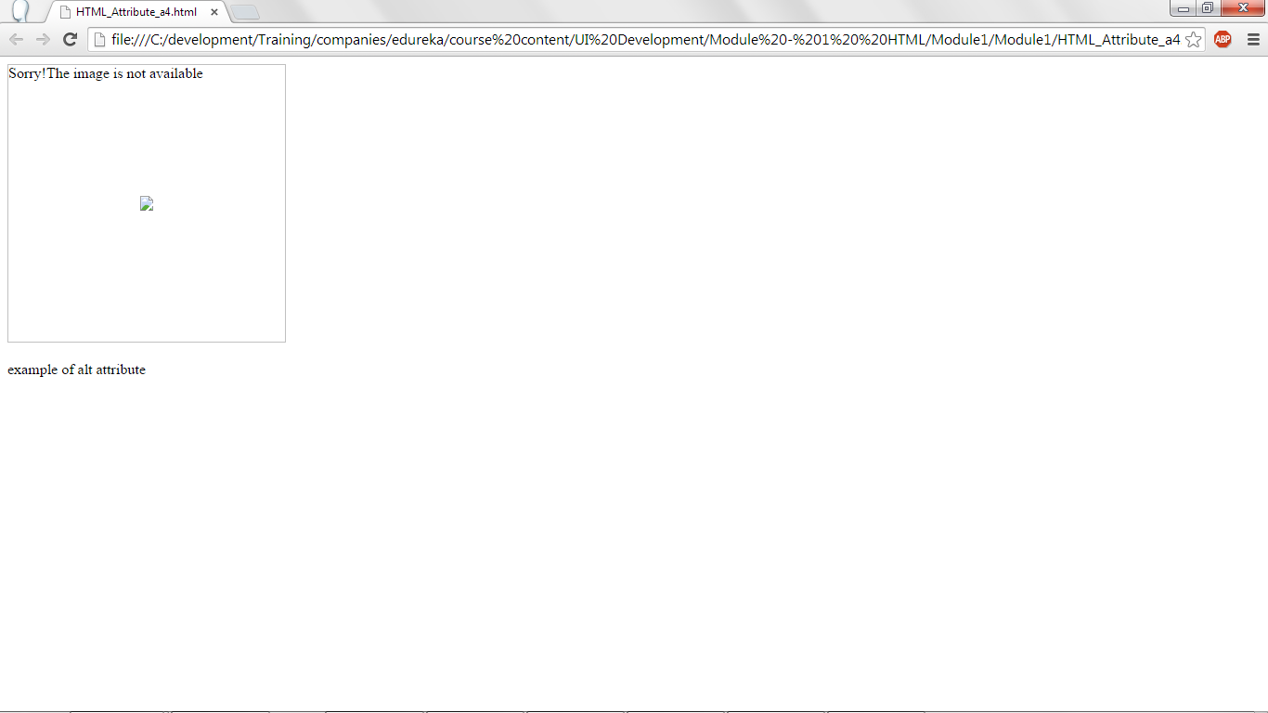
HTML alt attribute – output.

Slide 26
HTML Header.
<html>
<head>
<title>My Data
</title>
</head>
<body>
</body>
</html>
Head tag is the container for all the header elements of the HTML document.
Title tag is used to display the title for the html page. Here My Data will be displayed as the title for the web page.
Along with title, following tags can be specified in the header tag.
  Style – For specifying CSS styles.
  Script – For writing the java script or Jquery script.
  Link – For linking an external stylesheet.
All these tags, you will learn in upcoming modules.

Slide 27
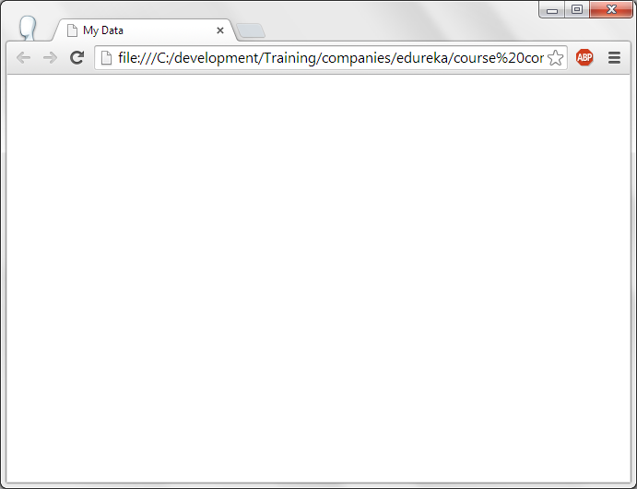
HTML Header - output

Slide 28
HTML Headers.
<!DOCTYPE html>
<html>
<body>
<h1>The Search Engines</h1>
<h2>History of Big Multinational Companies</h2>
<h3>Google</h3>
<p>Google was founded by Larry Page and Sergey Brin while they were Ph.D. students at Stanford University. Together they own about 14 percent of its shares but control 56 of the stockholder voting power through supervoting stock. They incorporated Google as a privately held company on September 4, 1998. An initial public offering followed on August 19, 2004. Its mission statement from the outset was "to organize the world's information and make it universally accessible and useful,"[9] and its unofficial slogan was "Don't be evil."[10][11] In 2004, Google moved to its new headquarters in Mountain View, California, nicknamed the Googleplex.[12]</p>
<h3>Yahoo!</h3>
<p>Yahoo! Inc. is an American multinational Internet corporation headquartered in Sunnyvale, California. It is globally known for its Web portal, search engine Yahoo Search, and related services, including Yahoo Directory, Yahoo Mail, Yahoo News, Yahoo Finance, Yahoo Groups, Yahoo Answers, advertising, online mapping, video sharing, fantasy sports and its social media website. It is one of the most popular sites in the United States.[3] According to news sources, roughly 700 million people visit Yahoo websites every month.[4][5] Yahoo itself claims it attracts "more than half a billion consumers every month in more than 30 languages."[6]</p>
</body>
</html>

Slide 29
HTML Headers.
H1 to H6 can be used as HTML header tags.
H1 is header 1 and H2 is header 2 and so on.
H1 is displays header in bigger size, H2 displays the header in lesser size when compared H1 and it continues till H6.

Slide 30
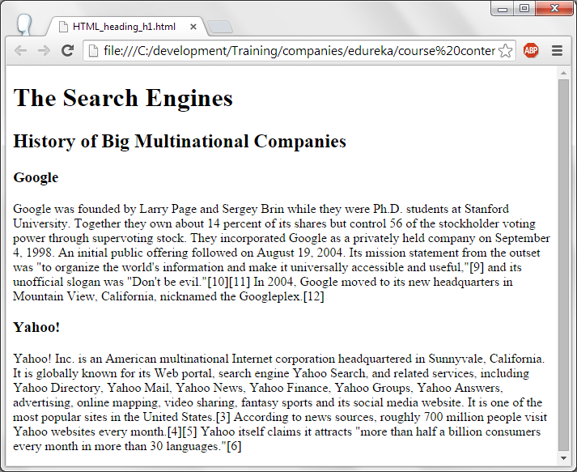
HTML Headers – Output.

Slide 31
HTML Header
<!DOCTYPE html>
<html>
<body>
<h1>The Search Engines</h1>
<hr/>
<h2>History of Big Multinational Companies</h2>
<hr/>
<h3>Google</h3>
<p>Google was founded by Larry Page and Sergey Brin while they were Ph.D. students at Stanford University. Together they own about 14 percent of its shares but control 56 of the stockholder voting power through supervoting stock. They incorporated Google as a privately held company on September 4, 1998. An initial public offering followed on August 19, 2004. Its mission statement from the outset was "to organize the world's information and make it universally accessible and useful,"[9] and its unofficial slogan was "Don't be evil."[10][11] In 2004, Google moved to its new headquarters in Mountain View, California, nicknamed the Googleplex.[12]</p>
<hr/>
<h3>Yahoo!</h3>
<p>Yahoo! Inc. is an American multinational Internet corporation headquartered in Sunnyvale, California. It is globally known for its Web portal, search engine Yahoo Search, and related services, including Yahoo Directory, Yahoo Mail, Yahoo News, Yahoo Finance, Yahoo Groups, Yahoo Answers, advertising, online mapping, video sharing, fantasy sports and its social media website. It is one of the most popular sites in the United States.[3] According to news sources, roughly 700 million people visit Yahoo websites every month.[4][5] Yahoo itself claims it attracts "more than half a billion consumers every month in more than 30 languages."[6]</p>
<hr/>
</body>
</html>

Slide 32
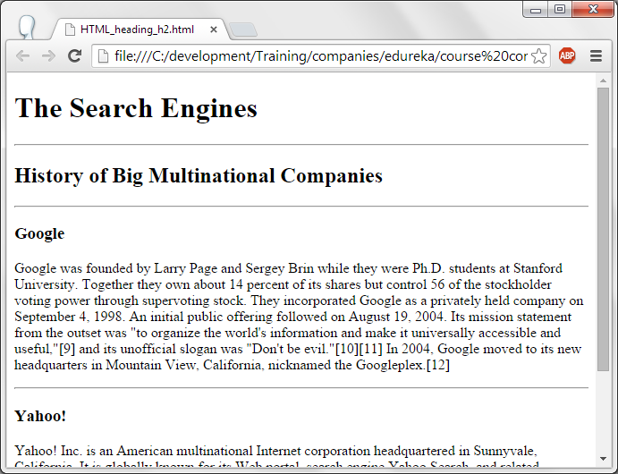
HTML Header
In this code, HR tag is used to display horizontal line as show below.

Slide 33
HTML Paragraphs.
<html>
<body>
<h1>Samsung develops five times faster WiFi technology: Samsung Electronics</h1>
<p> Samsung Electronics said it has developed a WiFi technology that can increase data transmission speeds by five times the maximum rate possible with existing consumer electronics devices.</p>
<p>The 60 GHz WiFi technology will enable a 1GB movie to be transferred between devices in less than three seconds while allowing uncompressed high-definition videos to be streamed in real time, the Suwon, South Korea-based company said in an e-mailed statement on Sunday. The technology removes the gap between theoretical and actual speeds, and exhibits actual speeds more than 10 times faster than with existing WiFi technologies, it said.</p>
<p>
"Samsung has successfully overcome the barriers to the commercialisation" of the 60 GHz Wi-Fi technology, Kim Chang Yong, head of a Samsung R&D centre, said in the statement. "New and innovative changes await Samsung's next-generation devices, while new possibilities have been opened up for the future development of WiFi."
</p>
<br/>
<p>This is example of using tag p </p>
</body>
</html>

Slide 34
HTML Paragraphs.
P tag is used to define the paragraphs.
Multiple P tags can be used to define the many paragraphs in the HTML code.
P end tag </P> : After displaying Paragraph it inserts a blank line in the browser window.
<br/> is a break line tag. This tag is used to insert a blank line in the browser window.

Slide 35
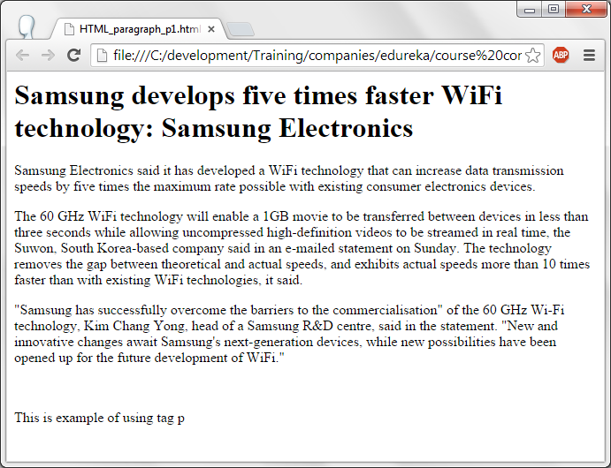
HTML Paragraphs.

Slide 36
HTML Paragraphs with <pre> tag.
<html>
<body>
<pre>
RESUME
EDUCATION:
UNIVERSITY OF MINNESOTA City, State College of Design May 2011
Bachelor of Science in Graphic Design
Cumulative GPA 3.93, Dean’s List
Twin cities Iron Range Scholarship
WORK EXPERIENCE:
AMERICAN EAGLE City, State
Sales Associate July 2009 - present
Collaborated with the store merchandiser creating displays to attract clientele
Use my trend awareness to assist customers in their shopping experience
Thoroughly scan every piece of merchandise for inventory control
Process shipment to increase my product knowledge
PLANET BEACH City, State Spa Consultant Aug. 2008 - present
Sell retail and memberships to meet company sales goals
Build organizational skills by single handedly running all operating procedures
Communicate with clients to fulfill their wants and needs
Attend promotional events to market our services
Handle cash and deposits during opening and closing
Received employee of the month award twice
HEARTBREAKER City, State Sales Associate May 2008 – Aug. 2008
Stocked sales floor with fast fashion inventory
Marked down items allowing me to see unsuccessful merchandise in a retail market
Offered advice and assistance to each guest
VICTORIA’S SECRET City, State Fashion Representative Jan. 2006 – Feb. 2009
Applied my leadership skills by assisting in the training of coworkers
Set up mannequins and displays in order to entice future customers
Provided superior customer service by helping with consumer decisions
Took seasonal inventory
</pre>
<br/>
<p>This is example of tag pre </p>
</body>
</html>

Slide 37
HTML Paragraphs with <pre> tag.
In this code <pre> tag is used.
This tag displays the pre formatted text as defined in the HTML code.
At times it is required to display the Web page in the pre defined format, in this scenario, <pre> tag can be used.

Slide 38
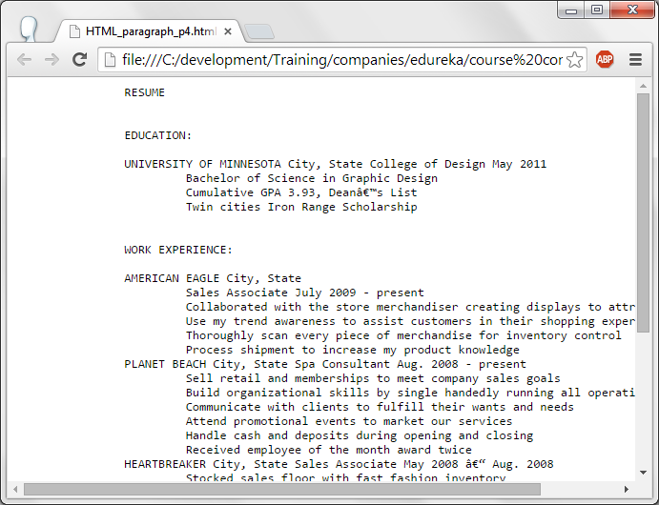
HTML Paragraphs with <pre> tag.

Slide 39
Formatting.
Some of the tags which can be used for Formatting are:
<b> - For bold.
<strong> - Emphasized bold
<i> - Italics.
<em> - Emphasized text. Displays in italics but emphasized more.
<mark> - Highlights the text like a highlighter.
<del> - Displays the text and strikes out.
<ins> - Inserted text. Displays text and underlines it as in word doc.
<sub> - Displays text in Subscript.
<sup> - Displays text in Superscript format.

Slide 40
HTML – Formatting.
<html>
<body>
<h2>An empirical analysis of package-modularization metrics: Implications for software fault-proneness </h2>
<p>
In a large <b>object-oriented software system</b>, packages play the role of <b>modules</b> which group related classes together to provide well-identified services to the rest of the system. In this context, it is widely believed that modularization has a large influence on the quality of packages.
</p>
<p>Example of bold:b tag</p>
</p>
</body>
</html>

Slide 41
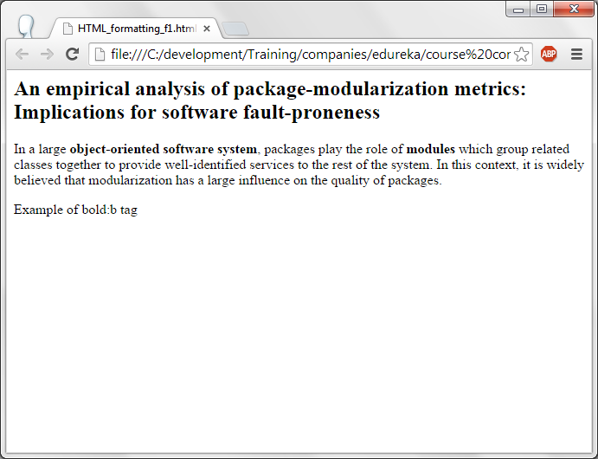
HTML Formatting – Bold.

Slide 42
HTML Formatting – Italics.
<html>
<body>
<h2>An empirical analysis of package-modularization metrics: Implications for software fault-proneness </h2>
<p>
These package-modularization metrics are quite different from traditional package-level metrics, which measure software quality mainly from <i>size, extensibility, responsibility, independence, abstractness, and instability</i> perspectives.
</p>
<p>example of italics</i>
</body>
</html>

Slide 43
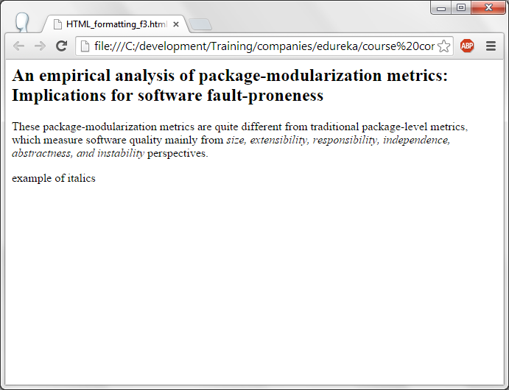
HTML Formatting – Italics - Output.

Slide 44
HTML Formatting – Mark and Delete
<html><body>
<h2>An empirical analysis of package-modularization metrics: Implications for software fault-proneness </h2>
<p>
In this paper, we examine the role of these new <mark>package-modularization</mark> metrics for determining software fault-proneness in object-oriented systems.<p>example of mark</i>
</body>
</html>
****************************************************************************************************
<html><body>
<h2>Samsung develops five times faster WiFi technology: Samsung Electronics</h2>
<p>
The announcement came as Samsung rolls out new products amid growing competition from Apple and Chinese companies.<del>ABCD</del></p>
<p>Example of deleted tag</p>
</body>
</html>

Slide 45
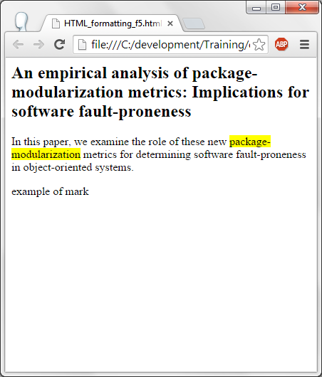
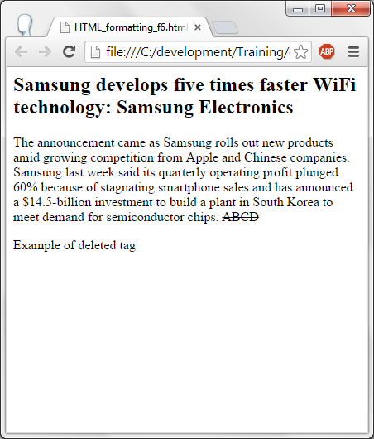
Output for mark and delete.

Slide 46
HTML Links.
HTML links are hyperlinks.
<a> tag is used for specifying links. <a> stands for anchor.
<a href="http://www.yahoo.com/html/">Yahoo</a>
Here Yahoo is the hyperlink and when clicked on this hyperlink, it opens a site yahoo.com in the browser.
As part of href, html files, asp/jsp files, web site links can be specified.

Slide 47
Hyperlinks.
<html><body>
<a href="HTML_formatting_f9.html">Click me to redirect to other page</a>
<p>Example of link tag</p>
</body></html>
Message click me to redirect to another page is displayed as hyperlink. When this hyperlink is clicked then it open HTML_formatting_f9.html.

Slide 48
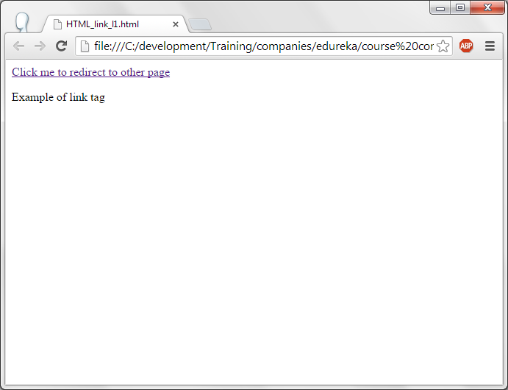
Hyperlinks – Output.

Slide 49
Image Hyperlinks .
<html> <body>
<a href="http://www.flipkart.com/moto-g-2nd-gen/p/itmdygz8gqk2w3xp?pid=MOBDYGZ6SHNB7RFC&otracker=from-search&srno=t_1&query=Moto+G&ref=9822d825-123d-450d-bbee-436e8dc1b8d1"><img src="HTML_link_4.jpg" /></a>
<p>Example of image as a link tag</p> </body>
</html>
Here the image is displayed rather than text using img src and when the image is clicked it opens the link given in href.

Slide 50
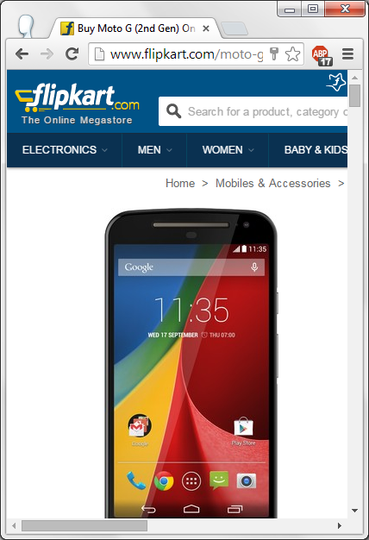
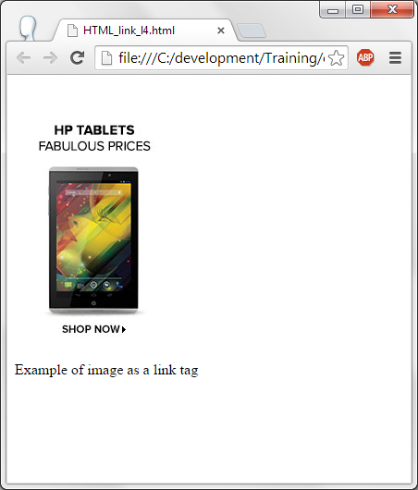
Image Hyperlinks – Output.

Slide 51
Changing colors of the hyperlinks.
<!DOCTYPE html>
<html>
<head>
<style>
a:link {color:#0000ff; }
a:visited {color:#000000; }
a:hover {color:#00ff00; }
a:active {color:#ff0000; }
</style>
</head>
<body>
<p>You can change the default colors of links</p>
<a href="http://www.yahoo.com" target="_blank">Yahoo.com</a>
</body></html>

Slide 52
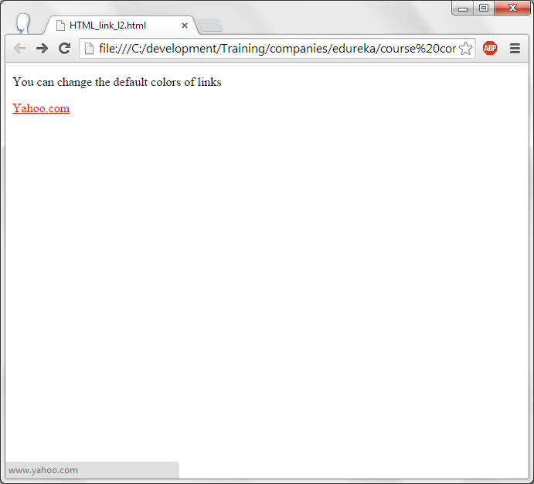
Output.

Slide 53
Colors in hyperlink.
<style> tag is used to specify the style of the web page.
You will learn more about it in CSS (Module – 3 to Module – 5).
  Link --> unvisited link.
  Visted --> When the link is visited.
  Hover --> When the mouse cursor is placed on the element.
  Active --> When the hyperlink is clicked, link becomes active.

Slide 54
Specifying style for HTML Elements.
<!DOCTYPE html><html>
<style>
body{
background-color:red;}
</style><body>
<p style="color:blue;background:yellow;">This is an Example of Inline CSS.Here CSS is defined in style attribute</p>
</body></html>
Here the text This is an example of Inline CSS is displayed using P tag. Color of the text is blue and the background color of the text is yellow. Setting the background color of the page in red color in Style tag. Style for all the elements of the body tag can be specified in body{}

Slide 55
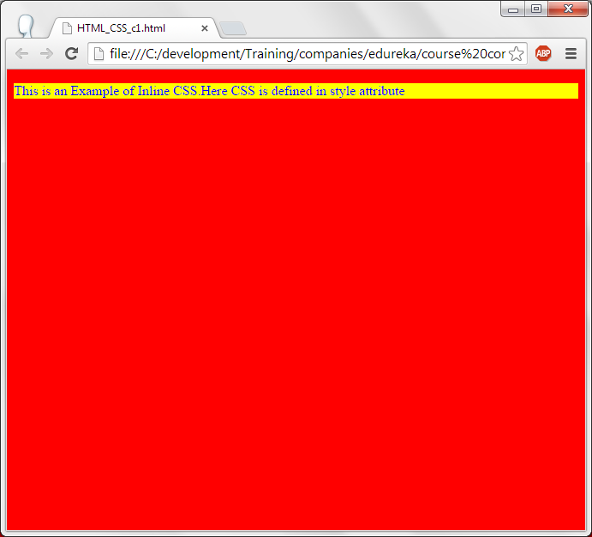
Output.

Slide 56
Style for HTML code.
<!DOCTYPE html><html>
<head>
<link rel="stylesheet" type="text/css" href="mystyle.css">
<style>
body {background-color:blue;}
p {color:white;font-size:30px}
</style> </head><body>
<p>Css within same page:Internal CSS</p>
</body>
</html>
In continuation of the previous code, paragraph color and font-size is also specified in style tag and color of the body's background is changed from red to blue.

Slide 57
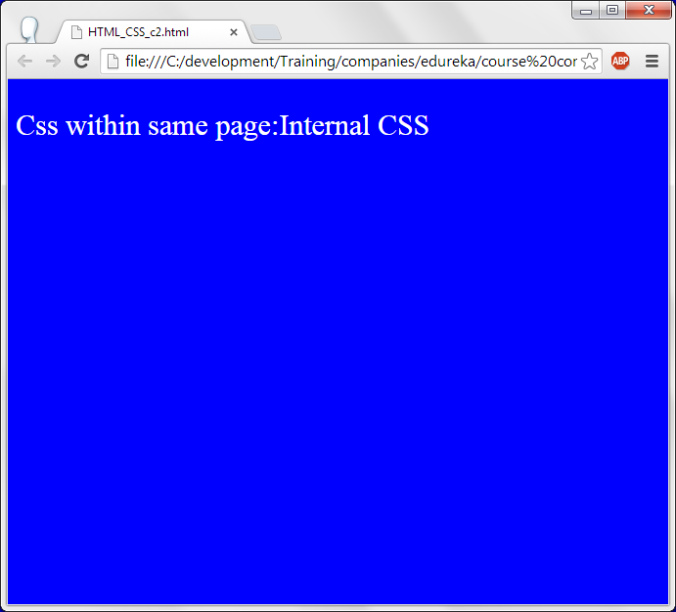
Output.

Slide 58
Linking with an external page.
<!DOCTYPE html><html>
<head>
<link rel="stylesheet" type="text/css" href="HTML_CSS_c3.css">
</head>
<body>
<p>External Css:CSS file attached to this page</p>
</body>
</html>
Css file
*********
body{
background-color : #DC143C;}
p{
background:#012450;
color:pink;
font-size:20px;}

Slide 59
Linking external css file.
Link tag refers to the external css file.
Rel – specifies the relationship between current web page and external document. Here we are referring to a stylesheet.
Type – Specifies the type of the linked document. It is text/css.
Href – specifies the name of the css file.

Slide 60
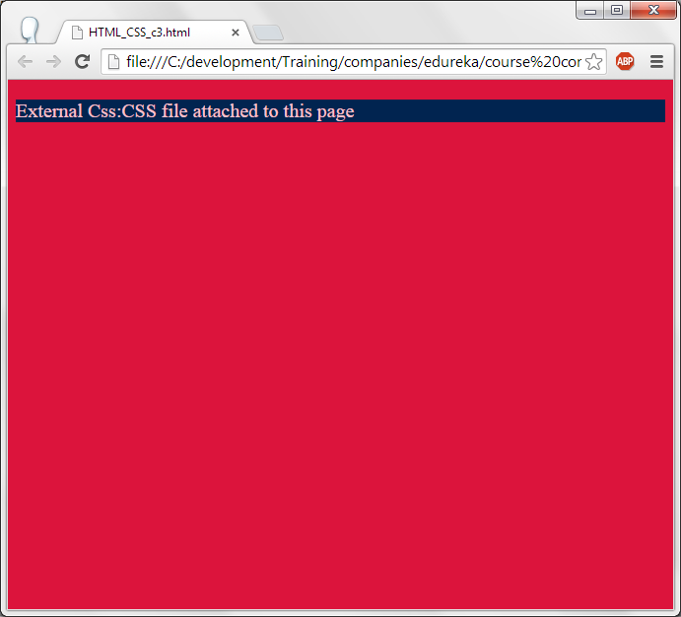
Output.

Slide 61
Images.
<html>
<body>
<h1>Example of moving Image or GIF Image</h1>
<img src="HTML_images_i4.gif"/>
</body>
</html>
<html>
<body>
<h1>Example of local Image</h1>
<img src="HTML_images_i1.jpg"/>
</body>
</html>
In these program jpg and gif images are displayed using <img> tag and src attribute.

Slide 62
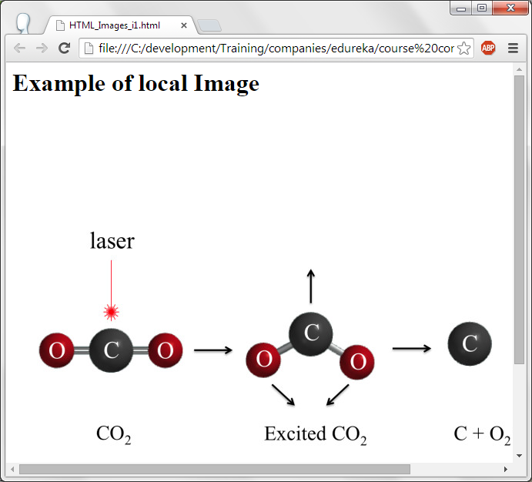
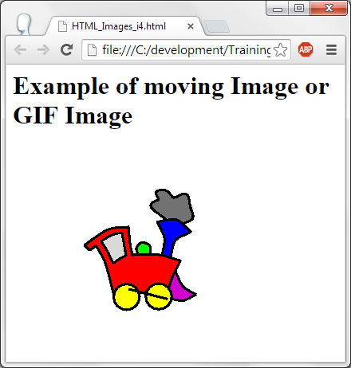
Output.

Slide 63
Image maps.
<html>
<body>
<h1>Example of Image as a map</h1>
<img src="HTML_images_i1.jpg" style="width:500px;height:500px" usemap="#chemicalmap"/>
<map name="chemicalmap">
<area shape="rect" coords="0,0,100,500" href="HTML_formatting_f9.html">
<area shape="rect" coords="101,0,300,500" href="HTML_formatting_f8.html">
<area shape="rect" coords="301,0,500,500" href="HTML_formatting_f7.html">
</map>
</body>
</html>

Slide 64
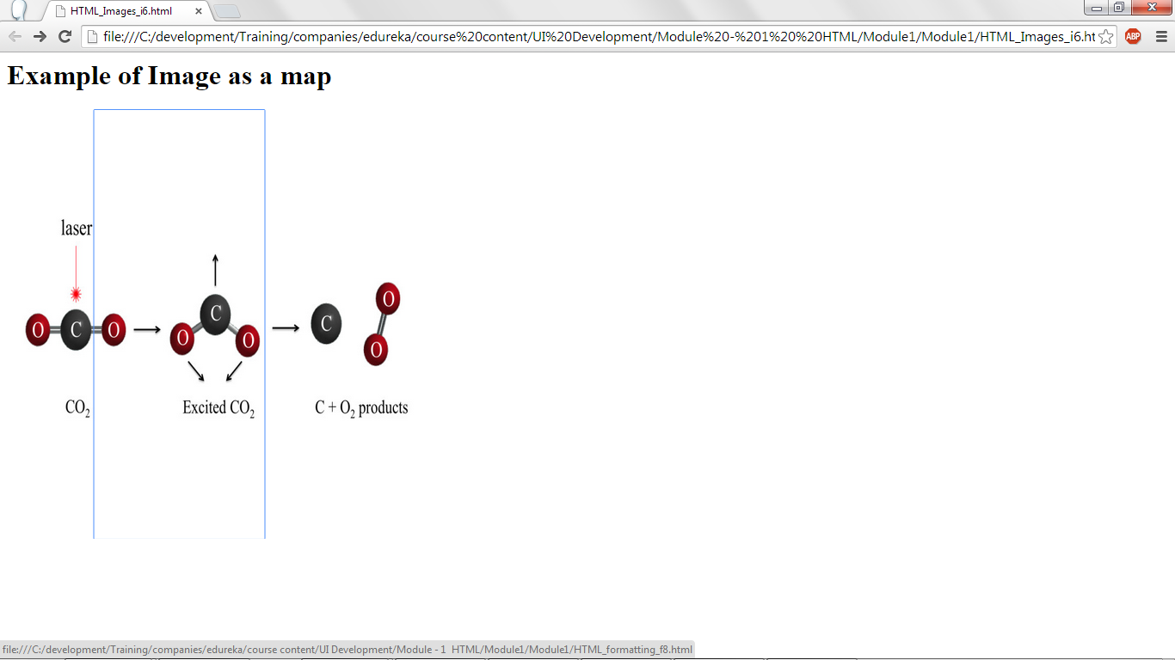
Output of image maps.

Slide 65
Image maps.
Image map can be used to devide an image into multiple hyperlinks by specifying the co-ordinates.
Co-ordinates should be specified in coords attribute. Co-ordinates specify square of left, top right, bottom. From left top to Right bottom a rectangle is formed and it is taken as one map. When any location in this map is clicked then specified html file is executed.

Slide 66
Blocks.
Many elements can be placed in one block using Div tag. Style for the entire block can be specified using style attribute in the div tag.
<!DOCTYPE html>
<html> <body>
<div style="background-color:#00dddd; color:black; margin:25px; padding:25px;">
<h2>HTML</h2>
<p>
In 1980, physicist Tim Berners-Lee, who was a contractor at CERN, proposed and prototyped ENQUIRE, a system for CERN researchers to use and share documents. In 1989, Berners-Lee wrote a memo proposing an Internet-based hypertext system.
The first publicly available description of HTML was a document called "HTML Tags", first mentioned on the Internet by Berners-Lee in late 1991.
</p>
</div>
<p>Example of block.div,p tags used for this</p>
</body></html>

Slide 67
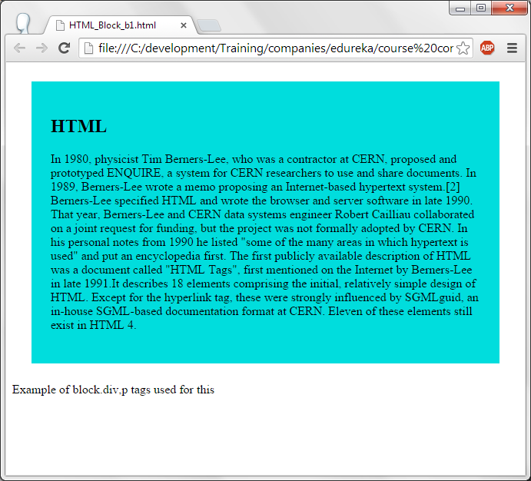
Output.

Slide 68
Blocks.
In the below given code, bolor-color, color of the text, margin and padding are specified as part of the div element. Div has Header. It can contain one or more elements. Span is used to specify the style for part of the text to displayed either in header or P or the tags which displays text.
<!DOCTYPE html>
<html>
<body>
<div style="background-color:#00dddd; color:black; margin:25px; padding:25px;">
<h1><span style="color:red">Important</span> code</h1>
</div>
<p>example of inline,span is the tag which can be used here</p>
</body>
</html>

Slide 69
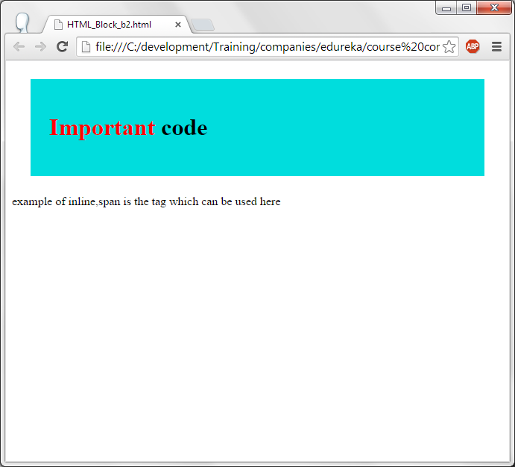
Output.

Slide 70
Tables
Table tag is used to write the tables in HTML.
<tr> is used to define the table row.
<td> is used to specify the table data. If we need 3 columns in a row then 3 <td> tags has to be specified.
<th> is used to specify the table header.
<row span=n> combines n rows.
<col span=n> combines n columns.

Slide 71
Table code.
<html>
<body>
<h1>Example of HTML table with border attribute</h1>
<table style="width:50%" border="1px">
<tr>
<td>Football</td>
<td>Germany</td>
<td>12</td>
</tr>
<tr>
<td>Cricket</td>
<td>Australia</td>
<td>12</td>
</tr>
<tr>
<td>Hocky</td>
<td>India</td>
<td>12</td>
</tr>
<tr>
<td>Atheletics</td>
<td>USA</td>
<td>12</td>
</tr>
</body>
</html><html>
<body>
<h1>Example of HTML table with border attribute</h1>
<table style="width:50%" border="1px">
<tr>
<td>Football</td>
<td>Germany</td>
<td>12</td>
</tr>
<tr>
<td>Cricket</td>
<td>Australia</td>
<td>12</td>
</tr>
<tr>
<td>Hocky</td>
<td>India</td>
<td>12</td>
</tr>
<tr>
<td>Atheletics</td>
<td>USA</td>
<td>12</td>
</tr>
</body>
</html>
Style attribute of table specifies the style for the table items like tr, td and th tag. As style, width=50% is given which is 50% of the window and border=”1px which specifies border for the window is 1px. Size of the border can be increased based on the requirement.
<tr> defines a row and football, Germany and 12 are added as columns in the first row. Another <tr> starts another row in the table and added Cricket, Australi and 12 as the 3 columns in the second row.

Slide 72
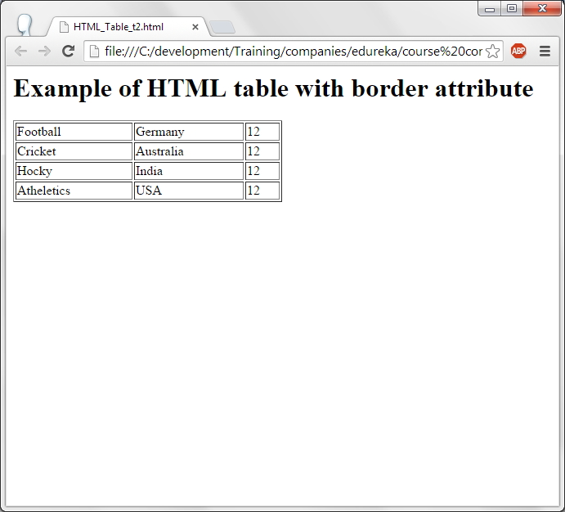
Output.

Slide 73
Table with header styles.
<html>
<head>
<style>
th
{
background-color:green;
color:white;
}
table, th, td {
border: 1px solid green;
border-collapse: collapse;
text-align:left;
}
</style>
</head>
<body>
<center>
<h1>Example of HTML table with heading</h1>
<table style="width:50%" >
<tr>
<th>Game</th>
<th>Country</th>
<th>Points</th>
</tr>
<tr>
<td>Football</td>
<td>Germany</td>
<td>12</td>
</tr>
<tr>
<td>Cricket</td>
<td>Australia</td>
<td>12</td>
</tr>
<tr>
<td>Hocky</td>
<td>India</td>
<td>12</td>
</tr>
<tr>
<td>Atheletics</td>
<td>USA</td>
<td>12</td>
</tr>
</center>
</body>
</html>

Slide 74
Table with header styles.
th{
background-color:green;
color:white;}
Specifies table header's background color is green and foreground color is white.
table, th, td {
border: 1px solid green;
border-collapse: collapse;
text-align:left;
}
This is for table, th and td tags : Border is displayed in green color. Border-collapse: collapse will make a single border rather than border for all the elements of the table. Text-align:left aligns the text of the table.

Slide 75
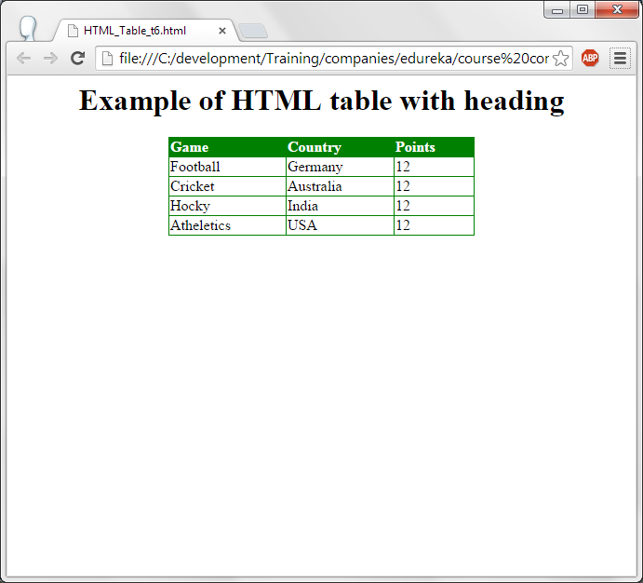
Output.

Slide 76
Row span in tables.
<html><head><style>
table, th, td {
border: 1px solid green;
border-collapse: collapse;}
th,td {
text-align: left;}
table tr:nth-child(even) {
background-color: #eee;}
table tr:nth-child(odd) {
background-color:#fff;}
table th {
background-color: black;
color: white;}</style>
</head>
<body>
<h1>Example of HTML caption</h1>
<table style="width:50%" >
<caption>Data</caption>
<tr> <th>Game</th> <th >Country</th> <th>Points</th> </tr>
<tr><td>Football</td><td>Germany</td><td>12</td></tr>
<tr><td>Cricket</td><td>Australia</td><td>12</td></tr>
<tr><td>Hocky</td><td>India</td> <td rowspan="2">12</td></tr>
<tr><td>Atheletics</td><td>USA</td></tr>
</body>
</html>

Slide 77
Row span in tables.
table tr:nth-child(even) specifies all the even rows of the table. table tr:nth-child(odd) specifies the odd rows of the table. For both the rows, background color is specified.
Rowspan="2" combines 2 rows and displays the data for the two rows.
Caption tag specifies the caption for the table and it is written on top of the table and at the center of the table.

Slide 78
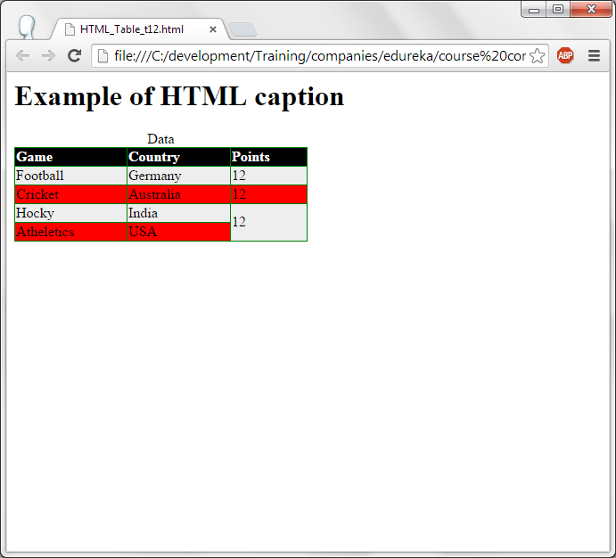
Output

Slide 79
Lists
List can be ordered list and unordered list.
Ordered list can be specified using <ol> tag. All the list items of the ordered list index will be displayed in the order like 1, 2, 3, 4 or A, B, C, D or i, ii, iii, iv etc.,
Un-ordered list can be specified using <ul> tag. Un-ordered list will display a symbol or icon infront of the list items. It does not specifiy any ordered numbers or alphabets infront of the list items.
<li> tag is used to specify the list item.
For unordered lsit : disc, circle, square and none can be used for list-style-type attribute to display the icons infront of the list data. If the disc is given as the list item symbol then all the list items of the un-ordered list will have small filled circle as the icon/symbol infront of each list item.
For ordered list : 1, A, a, I, i can be specified for type. If 1 is given as the type then the list displays 1, 2,3,4 etc. If the type is A then A, B, C, D is displayed for the list items.

Slide 80
Un-ordered list.
<!DOCTYPE html>
<html>
<body>
<h2>List of courses</h2>
<ul style="list-style-type:disc">
<li>HTML</li>
<li>CSS</li>
<li>javascript</li>
</ul>
<hr/>
<h2>List of courses</h2>
<ul style="list-style-type:circle">
<li>HTML</li>
<li>CSS</li>
<li>javascript</li>
</ul>
<hr/>
<h2>List of courses</h2>
<ul style="list-style-type:square">
<li>HTML</li>
<li>CSS</li>
<li>javascript</li>
</ul>
<hr/>
<h2>List of courses</h2>
<ul style="list-style-type:none">
<li>HTML</li>
<li>CSS</li>
<li>javascript</li>
</ul>
<hr/>
<p>Example of unordered list with disc,circle,square,none options</p>
</body>
</html>

Slide 81
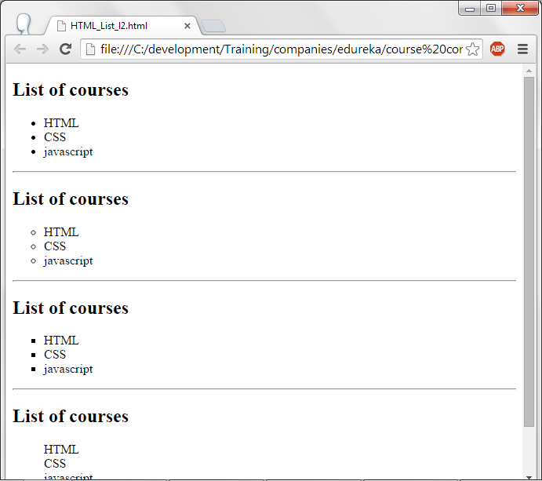
Output.

Slide 82
Ordered list.
<!DOCTYPE html>
<html>
<body>
<h2>List of courses</h2>
<ol type="1">
<li>HTML</li>
<li>CSS</li>
<li>Javascript</li>
</ol>
<hr/>
<h2>List of courses</h2>
<ol type="A">
<li>HTML</li>
<li>CSS</li>
<li>Javascript</li>
</ol>
<hr/>
<h2>List of courses</h2>
<ol type="a">
<li>HTML</li>
<li>CSS</li>
<li>Javascript</li>
</ol>
<hr/>
<h2>List of courses</h2>
<ol type="I">
<li>HTML</li>
<li>CSS</li>
<li>Javascript</li>
</ol>
<hr/>
<h2>List of courses</h2>
<ol type="i">
<li>HTML</li>
<li>CSS</li>
<li>Javascript</li>
</ol>
<p>Example of ordered list with different types</p>
</body>
</html>

Slide 83
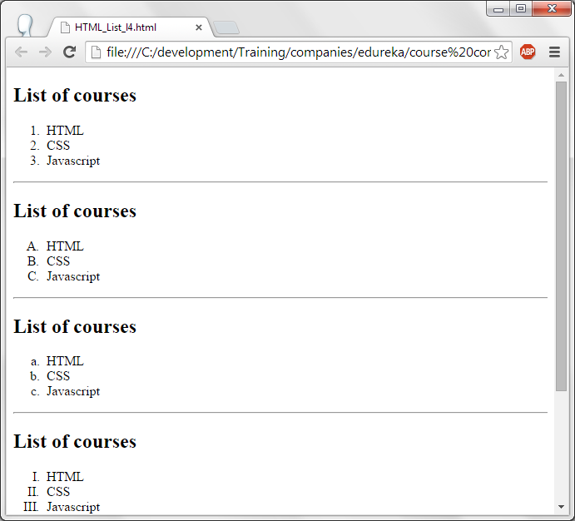
Output.

Slide 84
Layout.
A web site or web page can be displayed by dividing it into multiple sections. It will have
(a) Header
(b) Left menu items or anchors.
(c) Text to be displayed as the page.
(d) Footer.
All these items can be made using div section and style for each section can be specified in style tag.

Slide 85
Layout.
<!DOCTYPE html>
<html>
<head>
<style>
#header {
background-color:#11aadd;
color:white;
text-align:center;
padding:5px;
}
#nav {
line-height:30px;
background-color:#eeeeee;
height:500px;
width:100px;
float:left;
padding:5px;
}
#section {
width:350px;
float:left;
padding:10px;
}
#footer {
background-color:#11aadd;
color:white;
text-align:center;
padding:5px;
}
</style>
</head>
<body>
<div id="header">
<h1>HTML Layout Using Div</h1>
</div>
<div id="nav">
HTML<br>
CSS<br>
Javascript<br>
JQuery<br>
</div>
<div id="section">
<h2>HTML & History</h2>
<p>
In 1980, physicist Tim Berners-Lee, who was a contractor at CERN, proposed and prototyped ENQUIRE, a system for CERN researchers to use and share documents. In 1989, Berners-Lee wrote a memo proposing an Internet-based hypertext system.[2] Berners-Lee specified HTML and wrote the browser and server software in late 1990. That year, Berners-Lee and CERN data systems engineer Robert Cailliau collaborated on a joint request for funding, but the project was not formally adopted by CERN. In his personal notes from 1990 he listed "some of the many areas in which hypertext is used" and put an encyclopedia first.
</p>
<p>
The first publicly available description of HTML was a document called "HTML Tags", first mentioned on the Internet by Berners-Lee in late 1991.It describes 18 elements comprising the initial, relatively simple design of HTML. Except for the hyperlink tag, these were strongly influenced by SGMLguid, an in-house SGML-based documentation format at CERN. Eleven of these elements still exist in HTML 4.
</div>
<div id="footer">
Copyright © Edureka
</div>
</body>
</html>

Slide 86
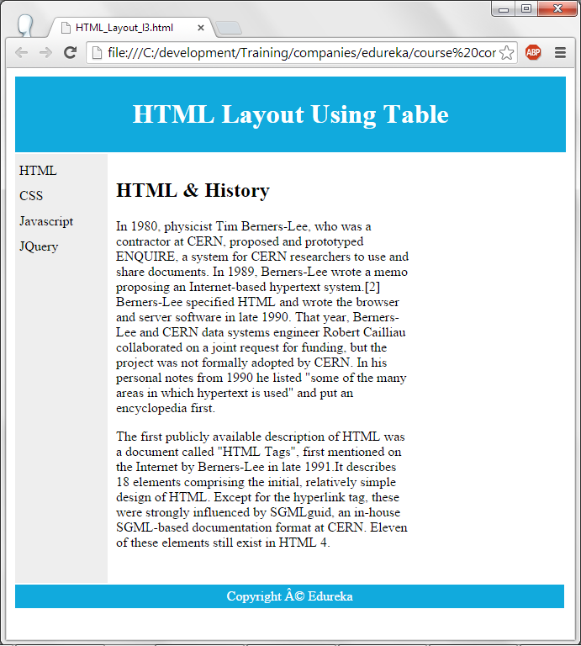
Output.

Slide 87
Forms.
Forms are used to send the data to the server.
Form elements will have Radio buttons, Check boxes, text areas, push buttons, drop down boxes, list boxes etc..,
<form> tag is used to write forms.
<input> for input. Type attribute will specify the type of the input. More details about the attribute are given below:
  text --> for text boxes.
  Button --> For push buttons.
  Radio --> For radio buttons.
  Checkbox --> For checkboxes.
  Submit --> For Submit button. When this button is pressed, data will be sent to the server.

Slide 88
Forms.
<html>
<body>
<form method="POST">
Your Name:<input type="text" name="t1" placeholder="Your Name"/>
</form>
<p>Example of Textbox</p>
</body>
</html>
<html>
<body>
<form method="POST">
Your Password:<input type="Password" name="p1" placeholder="Your Password"/>
</form>
<p>Example of Password</p>
</body>
</html>
<html>
<body>
<form method="POST">
Gender:<input type="radio" name="r1" value="Male">Male</input>
<input type="radio" name="r1" value="Female">Female</input>
</form>
<p>Example of radio button</p>
</body>
</html>
<html><body>
<form method="POST">
Skill:<input type="checkbox" name="c1" value="C">C</input>
<input type="checkbox" name="c2" value="C++">C++</input>
<input type="checkbox" name="c3" value="JAVA">JAVA</input>
<input type="checkbox" name="c4" value=".NET">.NET</input>
</form>
<p>Example of checkbox</p>
</body></html>

Slide 89
Forms
In the first example, text is used as the type which displays text box.
If the type is password then the typed text in the text box will be shown as “*”
Radio and Checkbox are used as types of forms to display Radio buttons and checkboxes.
Method=”post” says that entered data will not be seen as part of URL. “GET” also can be used as the option to transferring data from form/browser to the server. In this scenario, form data will be added to the URL.

Slide 90
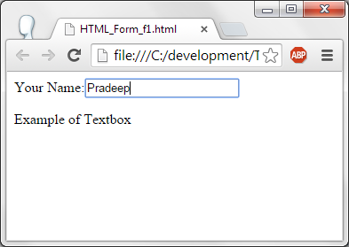
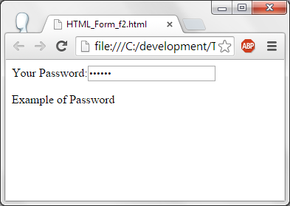
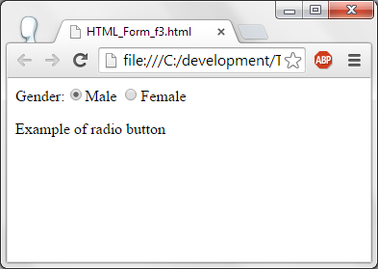
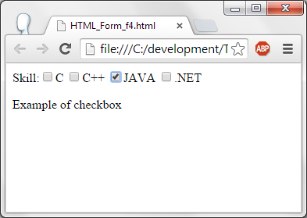
Output.

Slide 91
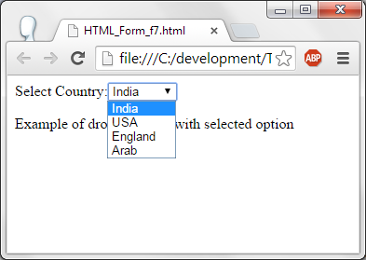
Form – Drop down list.
<html>
<body>
<form method="POST">
Select Country:<select name="Country">
<option value="India">India</option>
<option value="USA" selected>USA</option>
<option value="England">England</option>
<option value="Arab">Arab</option>
</select>
</form>
<p>Example of dropdown list with selected option</p>
</body>
</html>
Option specifies data. Value is the sent to the server when the data of the option is selected.

Slide 92
Form dropdown.
In form, method of sending the data from client to server is post, i.e., it will sent as part of the client body rather than client URL.
Select Country text will be displayed on browser. Name of this control is country. In CSS, Java Script this name can be used to get the data or perform some operation like changing style etc.,
Option data will be displayed to the user on browser. Value is the one which is sent to the server when the Option data is selected. Selected attribute specifies which list data is selected by default.

Slide 93
Form
<html> <body> <center>
<h1> User Registration Form </h1><br/><br/>
<form method="GET">
Name : <input type="text" id="name" /> <br/><br/><br/>
Password : <input type="password" id="name" /><br/><br/><br/>
Email : <input type="email" id="mail"/><br/><br/><br/>
Message : <textarea id="msg" class="textbox"></textarea><br/><br/><br/>
<input type="radio" name="sex" value="male">Male
<input type="radio" name="sex" value="female">Female<br/><br/><br/>
<input type="checkbox" name="skill" value="C">C
<input type="checkbox" name="skill" value="Java">Java
<input type="checkbox" name="skill" value="Hadoop">Hadoop
<input type="checkbox" name="skill" value="Storm">Storm <br/><br/><br/>
<input type="submit" value="Submit" >
</center>
</form>
</body>
</html>

Slide 94
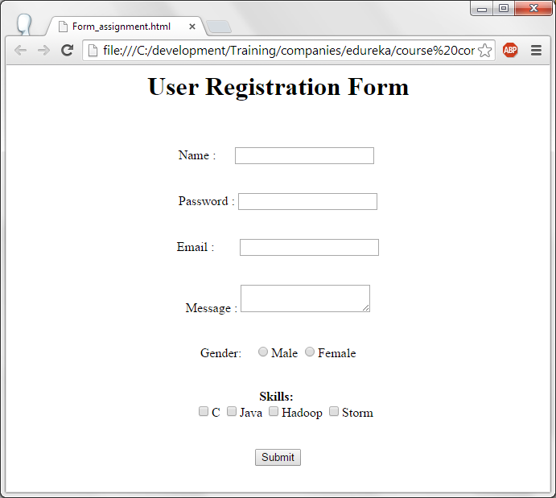
Output.

Slide 95
Iframes.
Iframes are used to display web site or web page with in another web page.
<!DOCTYPE html>
<html><body>
<p><a href="HTML_formatting_f8.html" target="Iframe1">Change data in Iframe</a></p>
<iframe src="HTML_formatting_f9.html" name="Iframe1"></iframe>
<p>Example of iframe with target</p>
</body></html>
In this example, Iframe is defined with <Iframe> tag and name of the iframe is given as iframe1. An hyperlink is given above the iframe “Change data in Iframe. When this hyperlink is clicked, html code will be placed in iframe with the name iframe1.

Slide 96
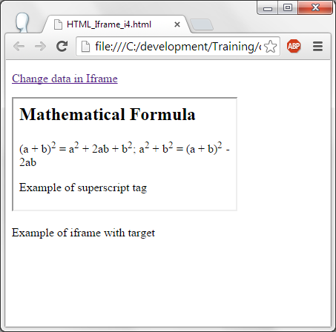
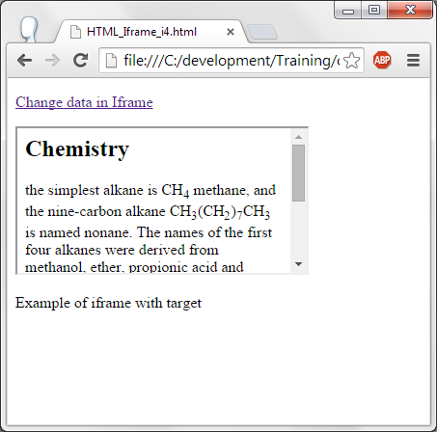
Output.

Slide 97
Color format.
Please combine the color format from these sites and place it in this presentation.
http://www.tutorialspoint.com/html/html_colors.htm
http://www.w3schools.com/tags/ref_colornames.asp

Slide 98
Entities.
Resererved characters and special symbols can be written using HTML entities.
Some of the HTML entities are
  &nbsp – Non breaking space.
  &lt - <
  &gt - >
  &amp - &
  &pound – £ (For poung symbol).
  &yen - ¥ (For yen symbol).
  &euro - € (For euro Symbol)
  &copy - © (For copy right symbol).

Slide 99
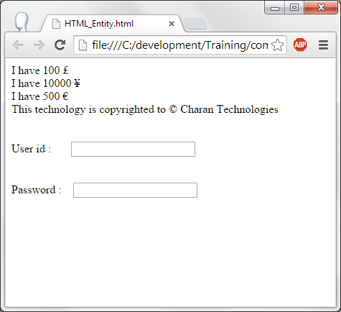
Entities.
<html>
<body>
I have 100 &pound <br/>
I have 10000 &yen <br/>
I have 500 &euro <br/>
This technology is copyrighted to &copy Charan Technologies <br/><br/><br/>
User id : &nbsp;&nbsp;&nbsp;&nbsp;&nbsp; <Input type="text" name="user_name"/><br/><br/><br/>
Password : &nbsp;&nbsp; <Input type="password" name="pwd"/>
</body>
</html>

Slide 100
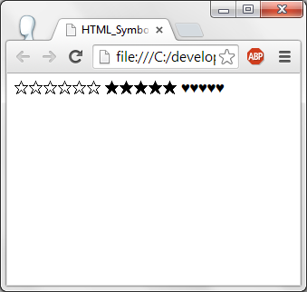
Symbols.
Some of the mathematical, greek letter and other symbols are not given in the keyboard. HTML provides them either in entities or in decimal values.
<html><body>
&#9734;&#9734;&#9734;&#9734;&#9734;&#9734;
&#x2605;&#x2605;&#x2605;&#x2605;&#x2605;
&#9829;&#9829;&#9829;&#9829;&#9829;
</body></html>
Here &#9734 is used to display white star as shown in the browser's output.

Slide 101
Symbols.
Please make this table...
Some Mathematical Symbols Supported by HTML
Char Number Entity Description
∀ &#8704; &forall; FOR ALL
∂ &#8706; &part; PARTIAL DIFFERENTIAL
∃ &#8707; &exist; THERE EXISTS
∅ &#8709; &empty; EMPTY SETS
∇ &#8711; &nabla; NABLA
∈ &#8712; &isin; ELEMENT OF
∉ &#8713; &notin; NOT AN ELEMENT OF
∋ &#8715; &ni; CONTAINS AS MEMBER
∏ &#8719; &prod; N-ARY PRODUCT
∑ &#8721; &sum; N-ARY SUMMATION
Some Other Entities Supported by HTML
Char Number Entity Description
© &#169; &copy; COPYRIGHT SIGN
® &#174; &reg; REGISTERED SIGN
€ &#8364; &euro; EURO SIGN
™ &#8482; &trade; TRADEMARK
← &#8592; &larr; LEFTWARDS ARROW
↑ &#8593; &uarr; UPWARDS ARROW
→ &#8594; &rarr; RIGHTWARDS ARROW
↓ &#8595; &darr; DOWNWARDS ARROW
♠ &#9824; &spades; BLACK SPADE SUIT
♣ &#9827; &clubs; BLACK CLUB SUIT
♥ &#9829; &hearts; BLACK HEART SUIT
♦ &#9830; &diams; BLACK DIAMOND SUIT

Slide 102
Character Set.
ASCII charset has characters between A – Z, 0 – 9 and some symbols.
ANSI (American National Standards Institute) – It supports 256 different characters codes.
ISO-8859-1 – Is the default character set in HTML4 and this character set also supports 256 different characters codes
UTF-8 covers allmost all the characters and symbols available in the world.
In HTML, Character set can be specified as given below:
  <meta charset="UTF-8">

